Slide 1
Data Bootcamp Project 1: Fantasy Football
Adam
Blaine
Christian
Jeff

Slide 2
Project Statement
For our project, we analyzed NFL players and their success in the NFL measured in fantasy football statistics. This included looking at a player’s college and their fantasy football success. We also looked at player position and across games within a season.
Motivations:
Interest in football.
Wondering if there were any strong relations between colleges/conferences and fantasy production.

Slide 3
Data questions
What colleges have the highest fantasy output since 2000?
What positions have the highest fantasy output since 2000?
What kind of fantasy production prediction can we make based on a new player’s college or conference?

Slide 4
Data Aggregation and Cleanup
Data from an API available through sportradar.com
This provider is a main source for up to date in game data for the NFL across many platforms involved with fantasy sports.
Limited to using 1,000 calls per API key for free.
Fantasy football data was a simple conversion from football stats.
10 yards = 1 points, 1 TD = 6 points, 1 fumble = -2 points (WR, RB, TE, FB)
25 yards = 1 points, 1 TD = 4 points, 1 fumble = -2 points, 1 interception = -2 points (QB)

Slide 5
Data Aggregation and Cleanup
Scripts we used aggregation and cleanup:

Slide 6
Data Analysis
Our data analysis for our main question we aimed to show which colleges had the most productive fantasy football players in the NFL over the last 17 seasons.

Slide 7
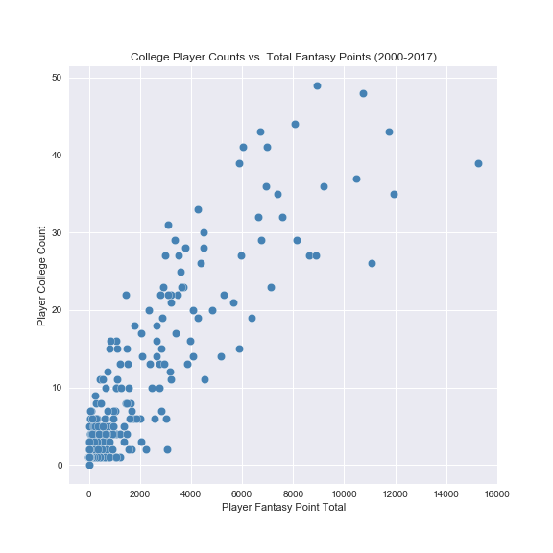
Scatter Plot
 | total points | playercount
Tennessee | 15253.06 | 39.0
Michigan | 11743.12 | 43.0
Ohio State | 8914.76 | 49.0
Penn State | 6694.88 | 43.0
UCLA | 3105.04 | 31.0
Florida | 10727.48 | 48.0
Alabama | 6640.36 | 32.0
Wisconsin | 6991.22 | 41.0
California | 11930.40 | 35.0
Stanford | 6045.58 | 41.0
Michigan State | 9185.64 | 36.0
Florida State | 7383.60 | 35.0
Notre Dame | 8081.64 | 44.0
Oregon | 5871.40 | 39.0
Georgia | 10479.86 | 37.0
Auburn | 7593.54 | 32.0
Oklahoma | 6939.26 | 36.0
Washington | 4257.60 | 33.0

Slide 8
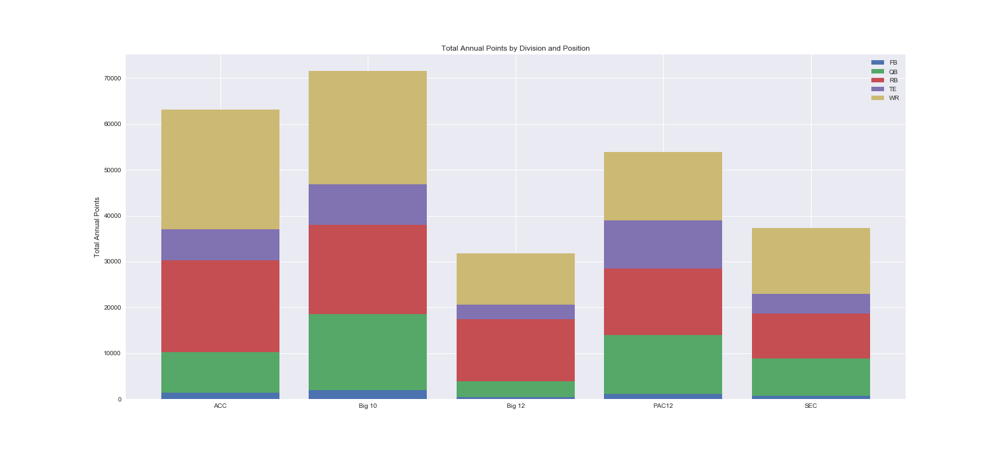
Stacked Bar - Conferences

Slide 9
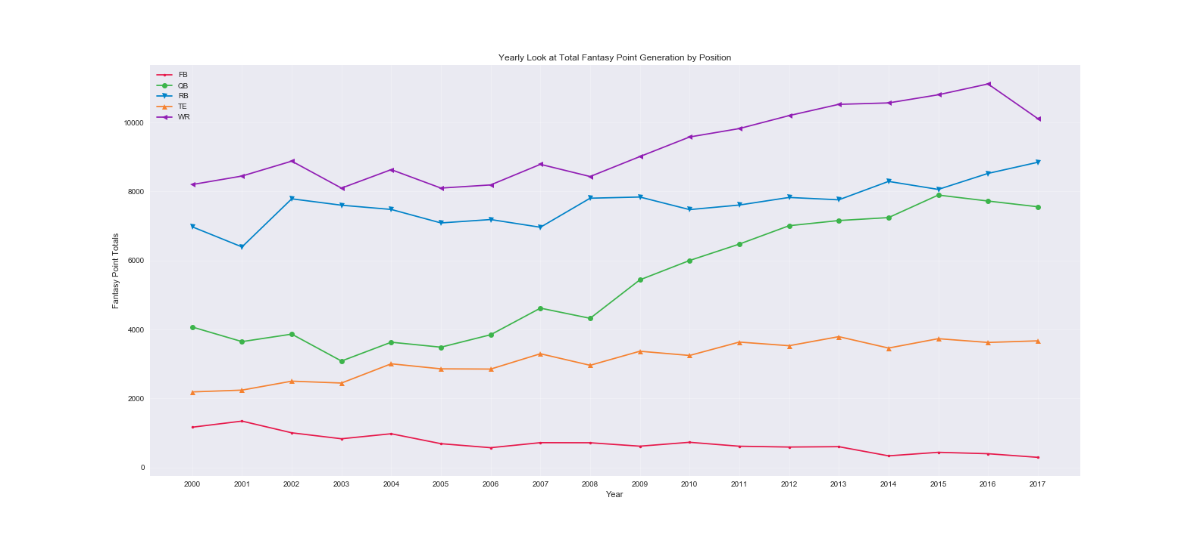
Position line graph

Slide 10
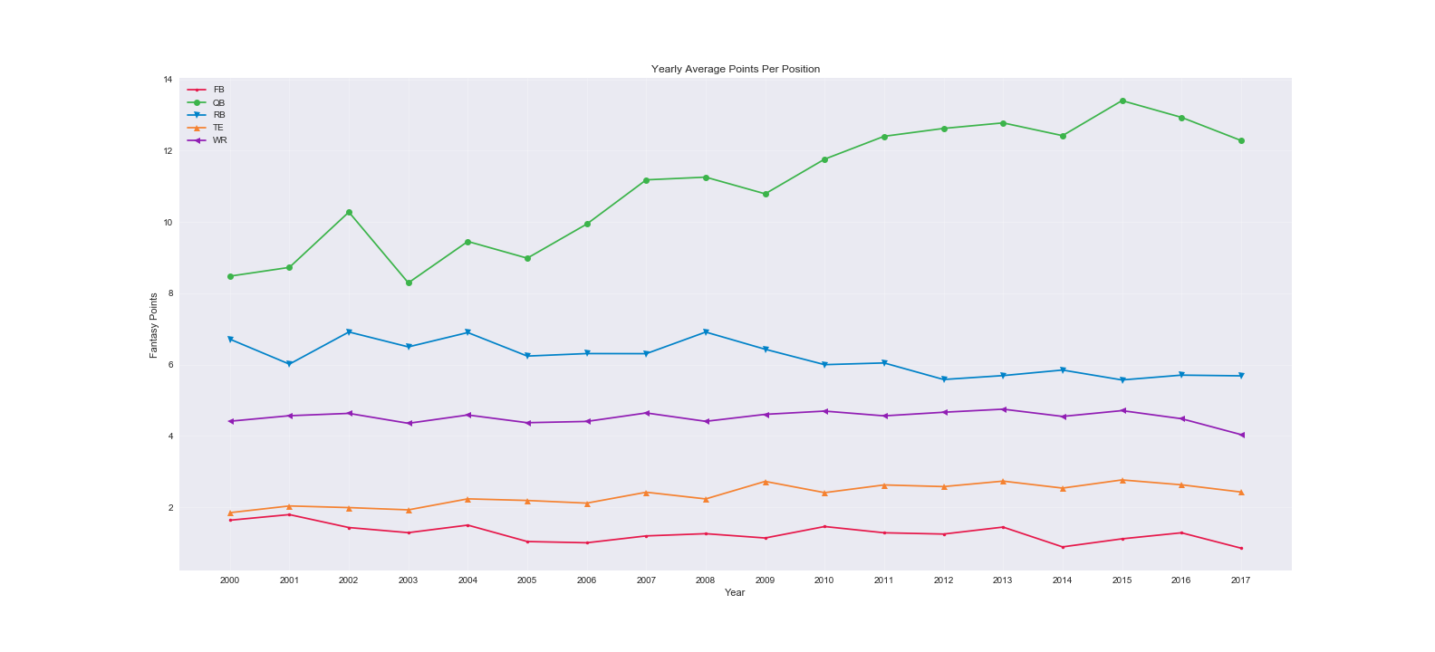
Position line graph: Average Points

Slide 11
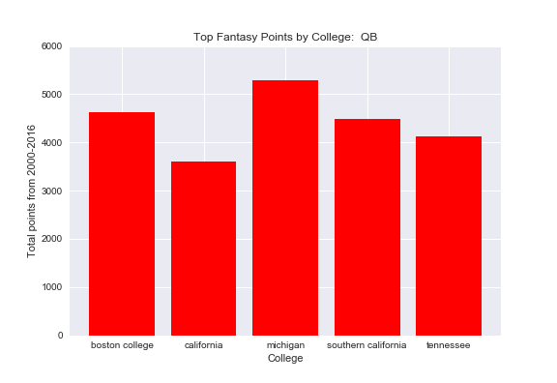
Top colleges - quarterbacks

Slide 12
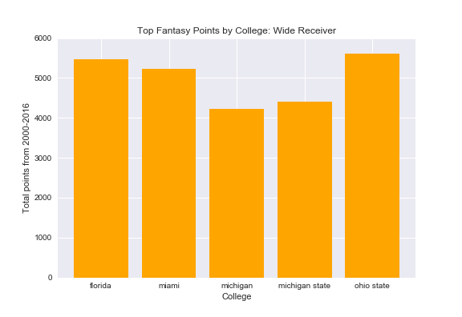
Top colleges – wide receivers

Slide 13
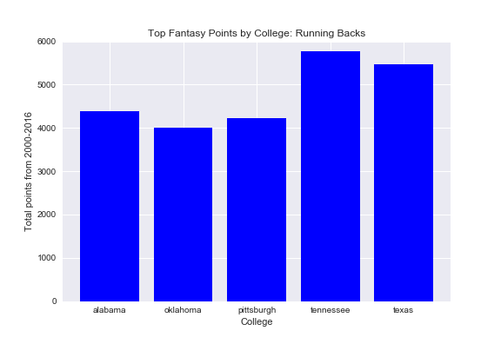
Top colleges – running backs

Slide 14
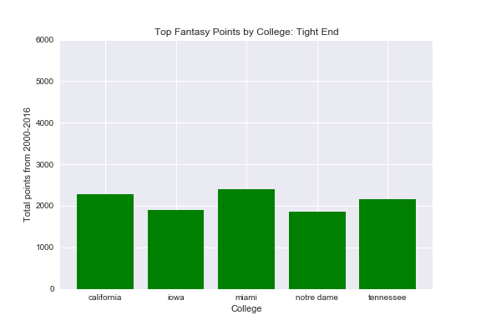
Top colleges – tight ends

Slide 15
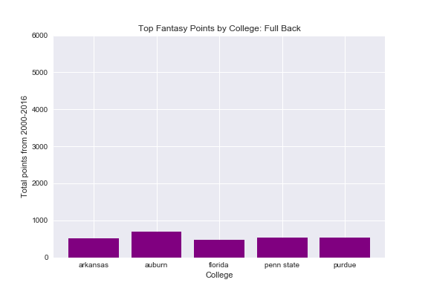
Top colleges – fullbacks

Slide 16
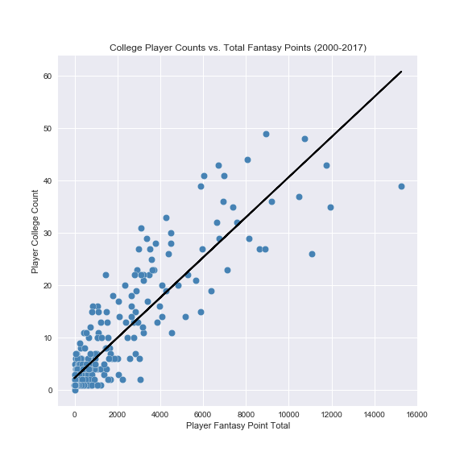
Scatter Plot: REgression
Slope = .0038366969
~260 pts. / player

Slide 17
Summary
What colleges have the highest fantasy output since 2000?
UT(TN) showed the highest fantasy output per player while the Big 10 had the most output for a conference.
What positions have the highest fantasy output since 2000?
WR has become the top position for fantasy output since 2000 and does not look like that will change soon.
What kind of fantasy production prediction can we make based on a new player’s college or conference?
On average a player should be expected to produce ~260 points over 18 seasons or ~14 points a year.

